Slide 1

AI23431 - WEBTECHNOLOGY AND MOBILE APPLICATION PROJECT REVIEW
LANGUAGE LEARNING APP WITH QUIZZES (LLAQ)
Presented by :
KING PAVIYON MANOVA J (241501086)
KARTHIK SAH E (241501080)

Slide 2

Introduction
LLAQ is a web-based platform for learning languages through structured lessons and quizzes.
Supports 8 languages and gamified learning.

Slide 3
Problem Statement
Traditional learning is costly, inflexible, and lacks interactivity.
Need for a self-paced, affordable, engaging platform.

Slide 4
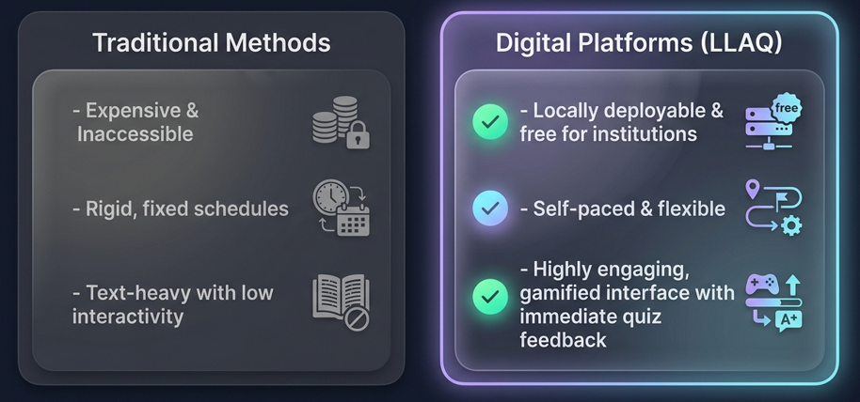
Objectives
Support multiple languages
Secure authentication
Gamified learning
Quiz-based assessment
Leaderboard system

Slide 5
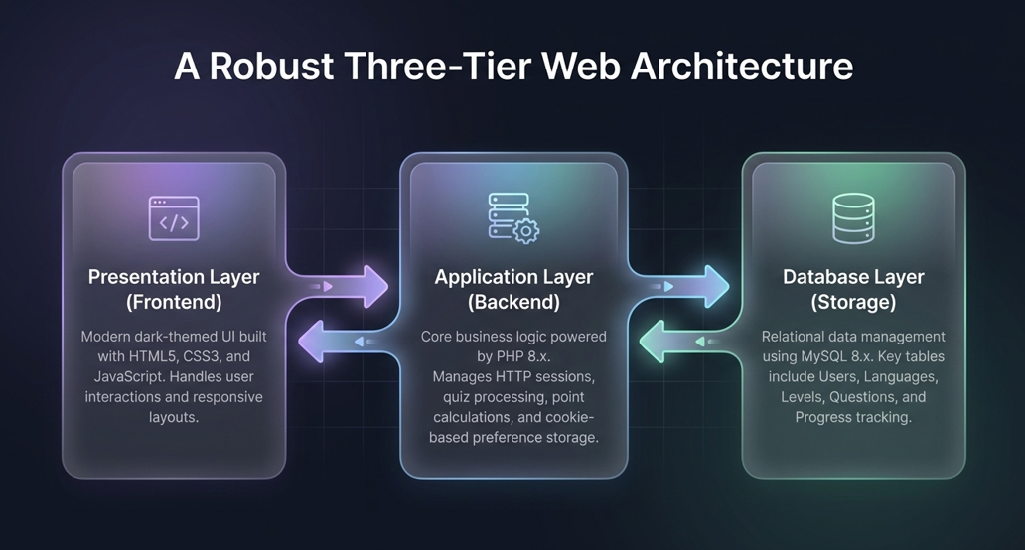
System Architecture

Slide 6
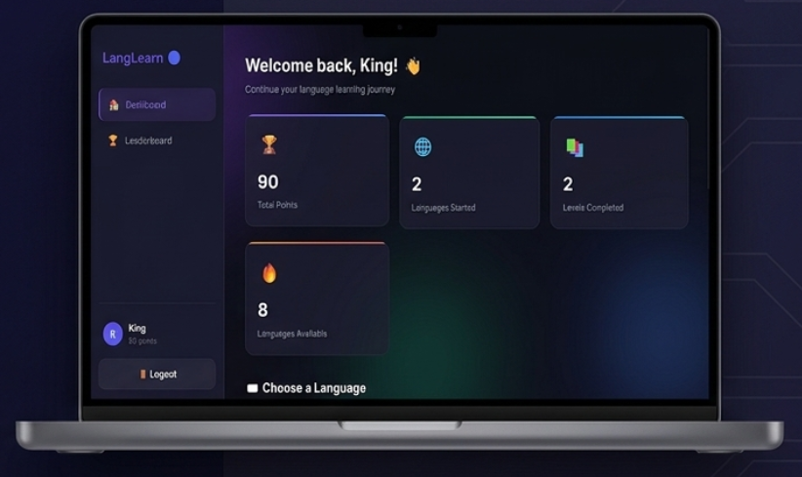
Key System Characteristics
Interactive UI
Secure sessions
Real-time scoring
Scalable design

Slide 7
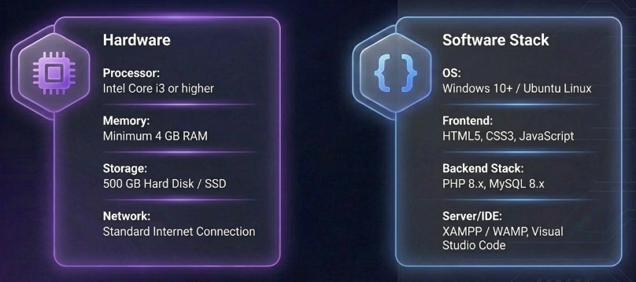
Hardware & Software Requirements

Slide 8
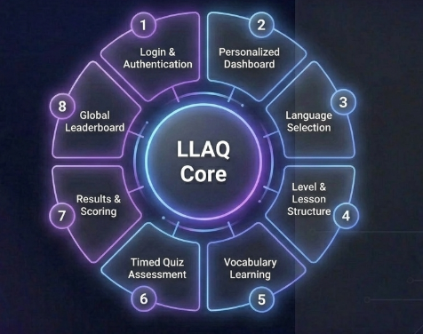
System Modules
Modules of the System
Login & Authentication
Personalized Dashboard
Language Selection
Level & Lesson Structure
Vocabulary Learning
Timed Quiz Assessment
Results & Scoring
Global Leaderboard

Slide 9
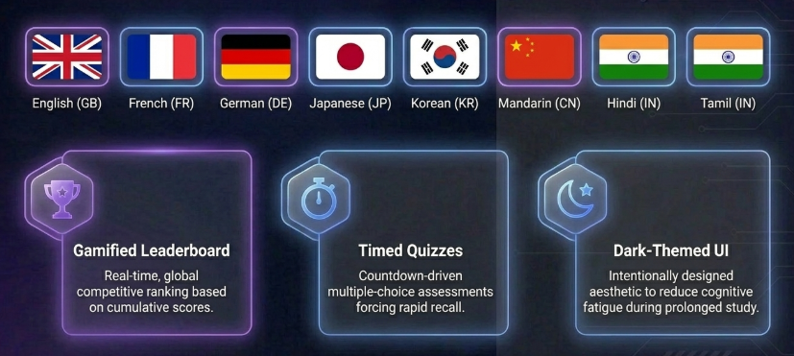
Key Features
Vocabulary cards
Timed quizzes
Points & levels
Leaderboard ranking

Slide 10
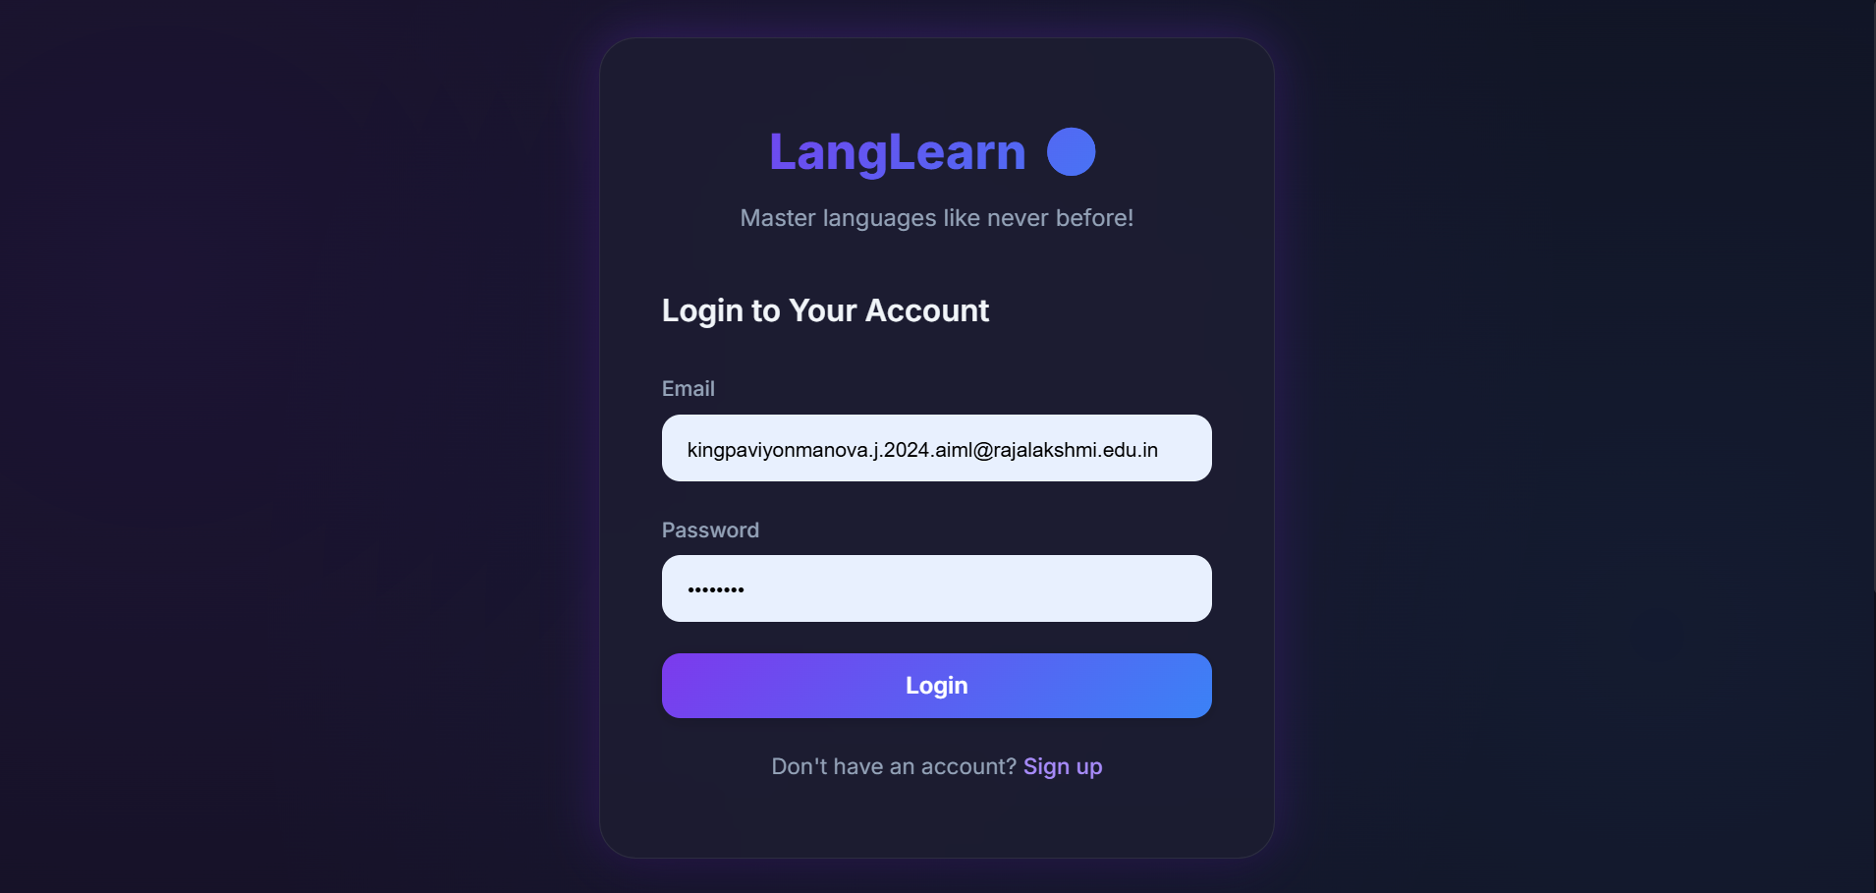

Slide 11
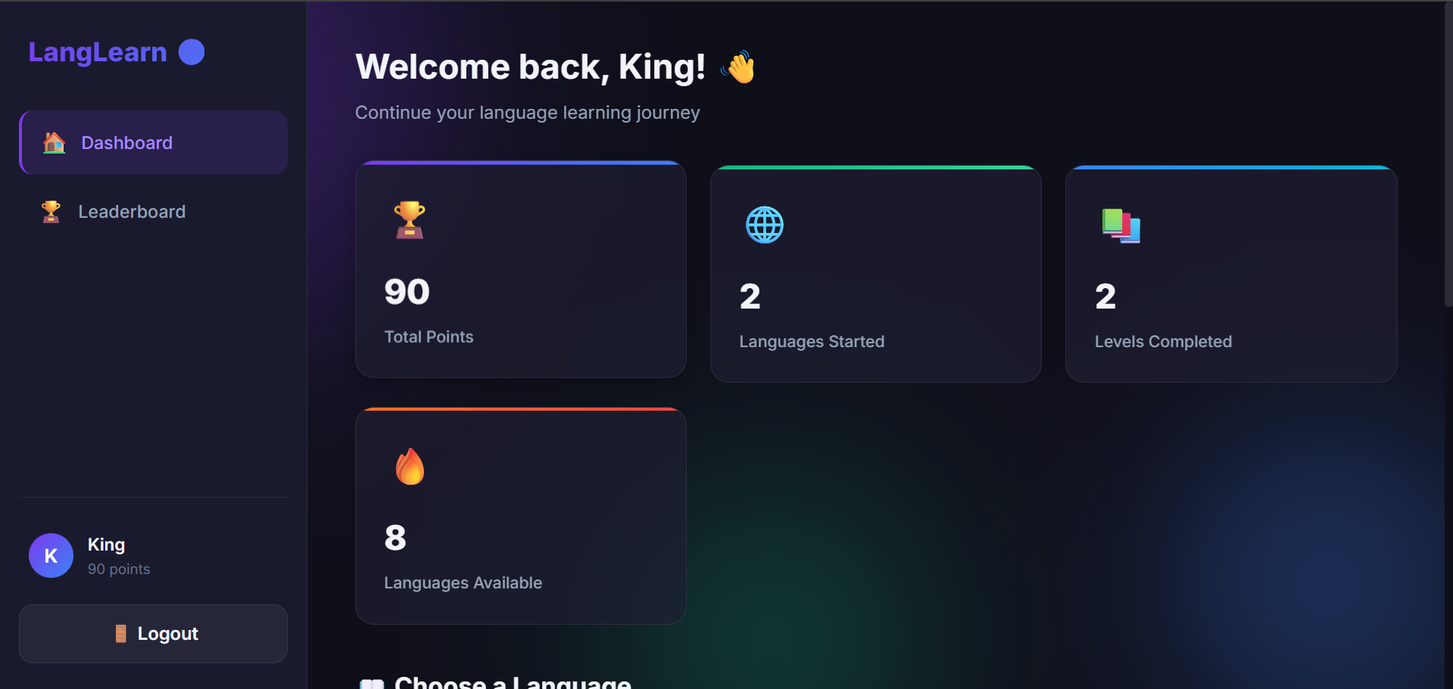
System Screenshots

Slide 12
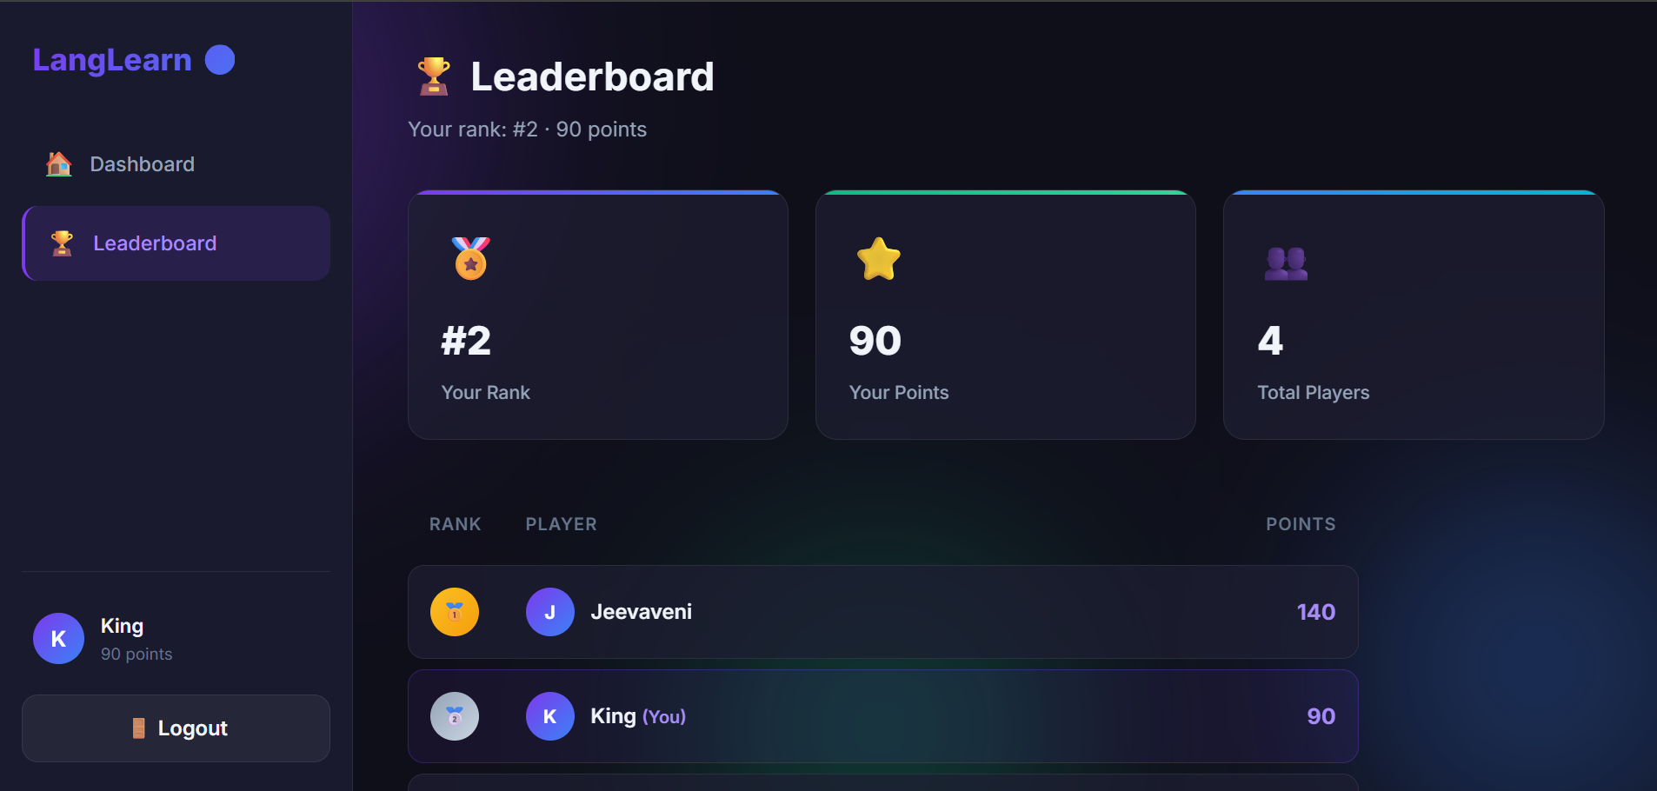

Slide 13
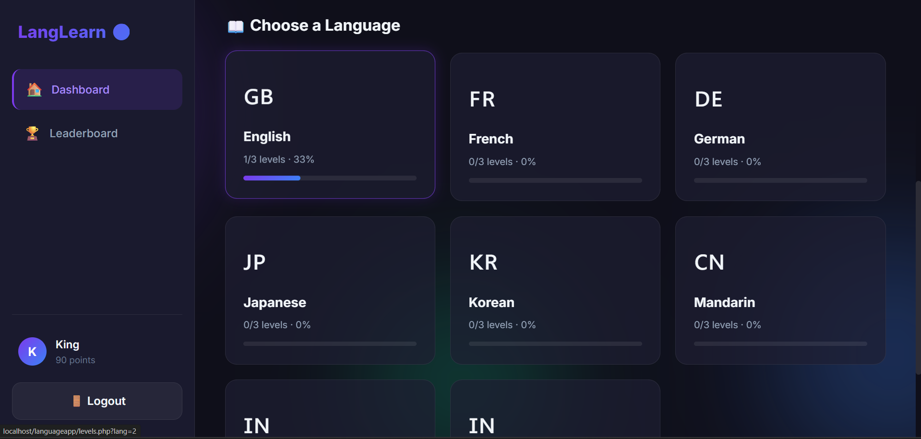

Slide 14
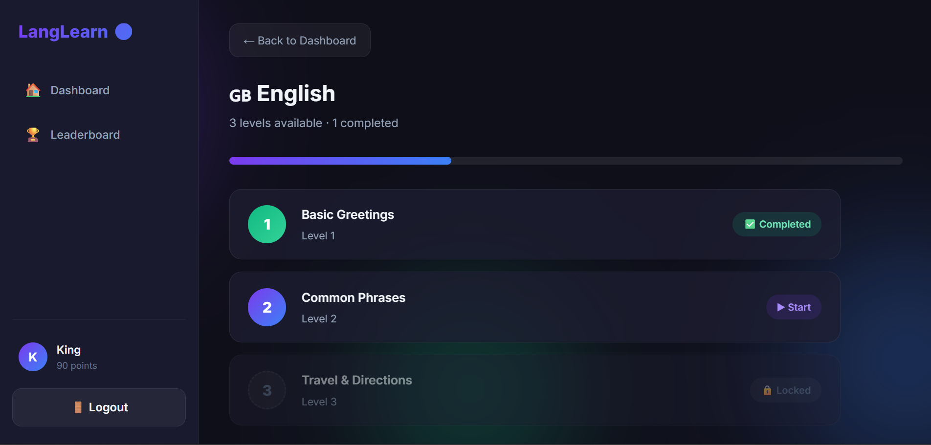

Slide 15
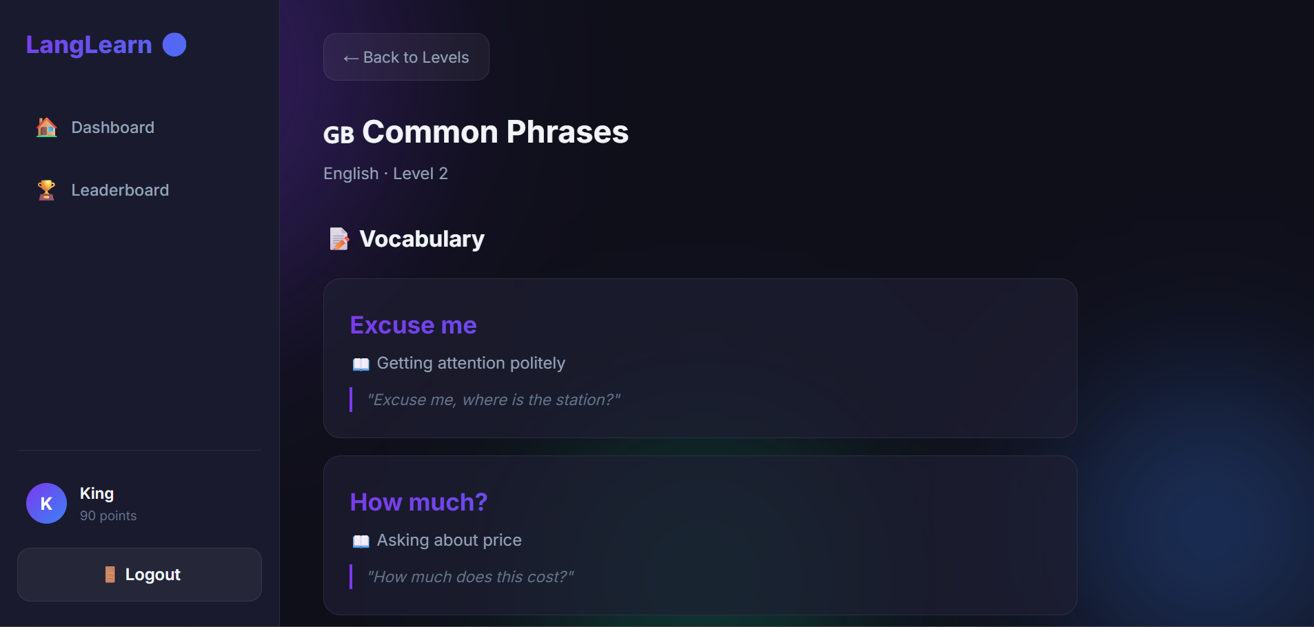

Slide 16
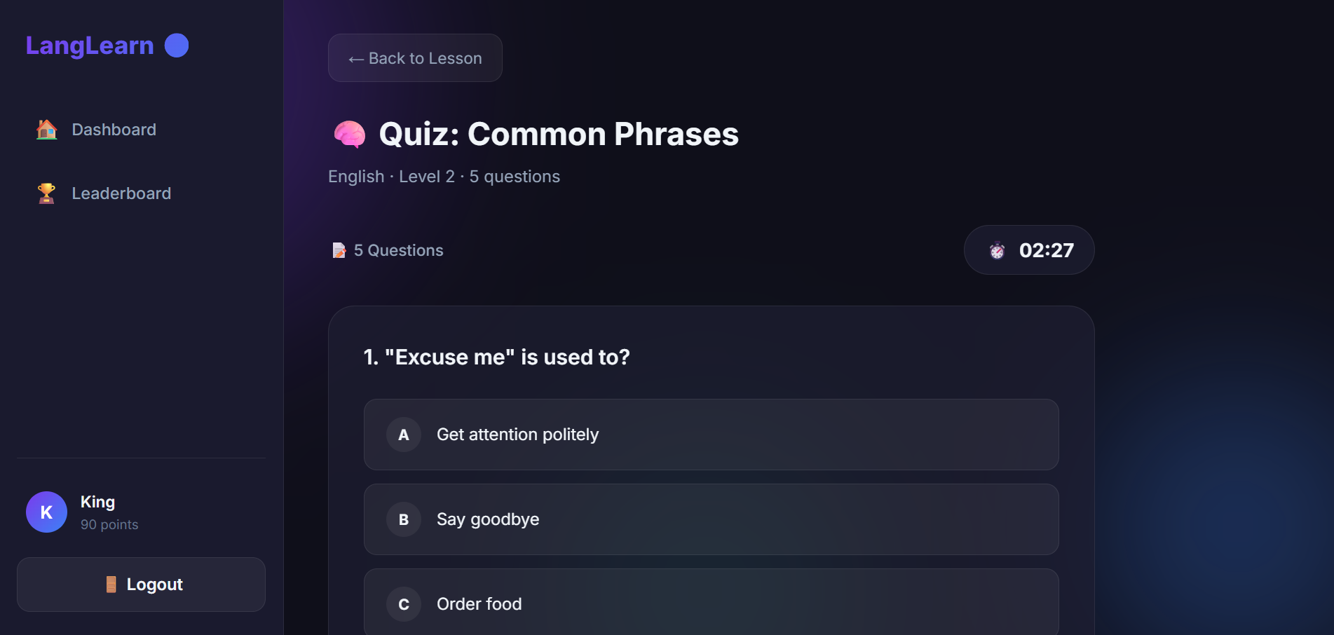

Slide 17
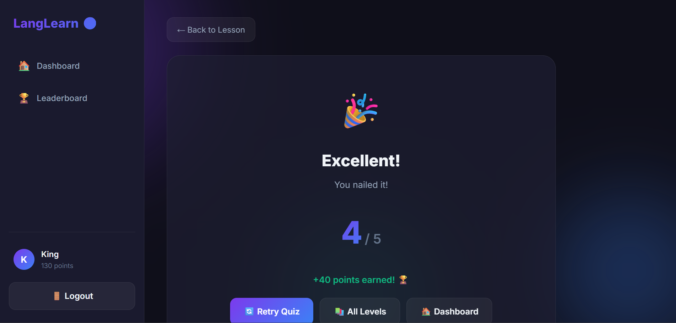

Slide 18
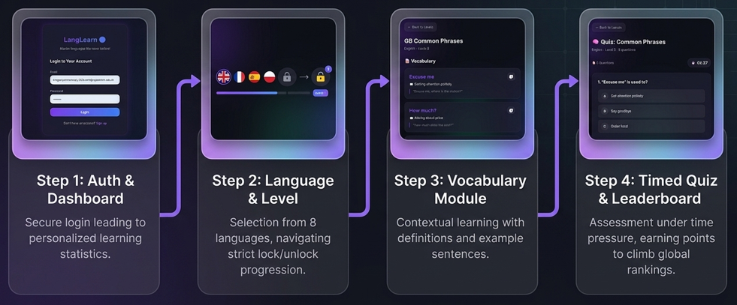

Slide 19
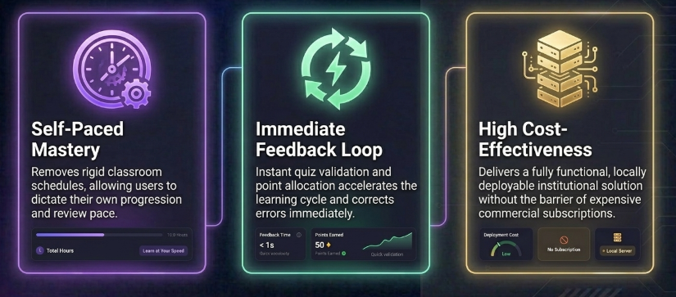
Advantages

Slide 20
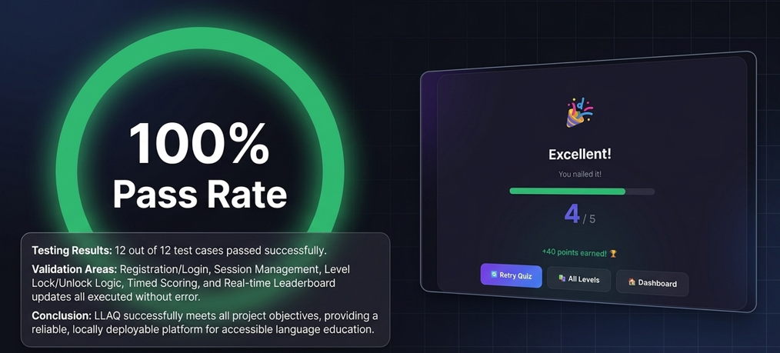
Results and Conclusion
• All modules tested successfully.
• System is reliable and ready for deployment.

Slide 21
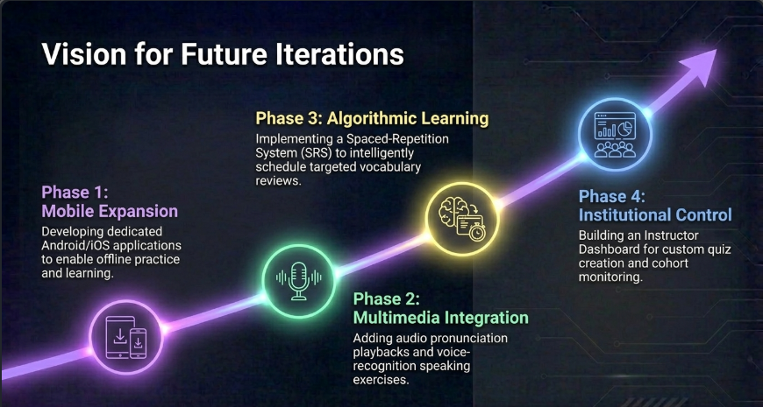
Future Enhancements
Mobile app
Audio pronunciation
SRS system
More languages

Slide 22
THANK YOU!!!

